Slide 1
Differential programming demo
Introduction
Using Zygote
Simple functions
Toy problems

Slide 2
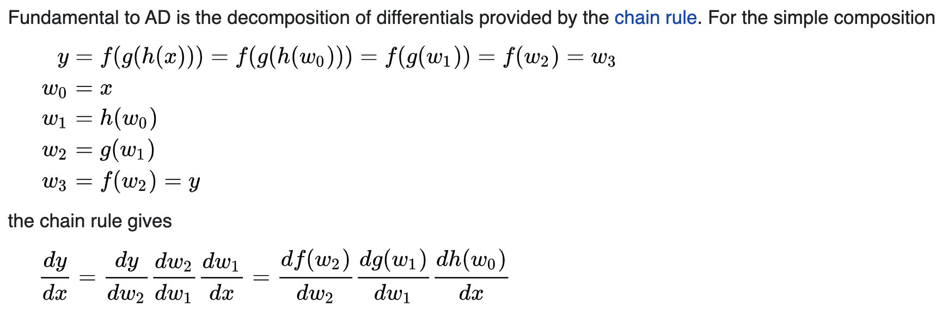
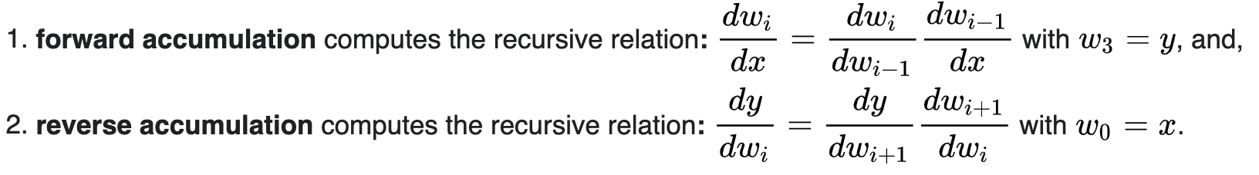
Intro
Code as composition of simple elementary operations and functions
Accurate to working precision

Slide 3
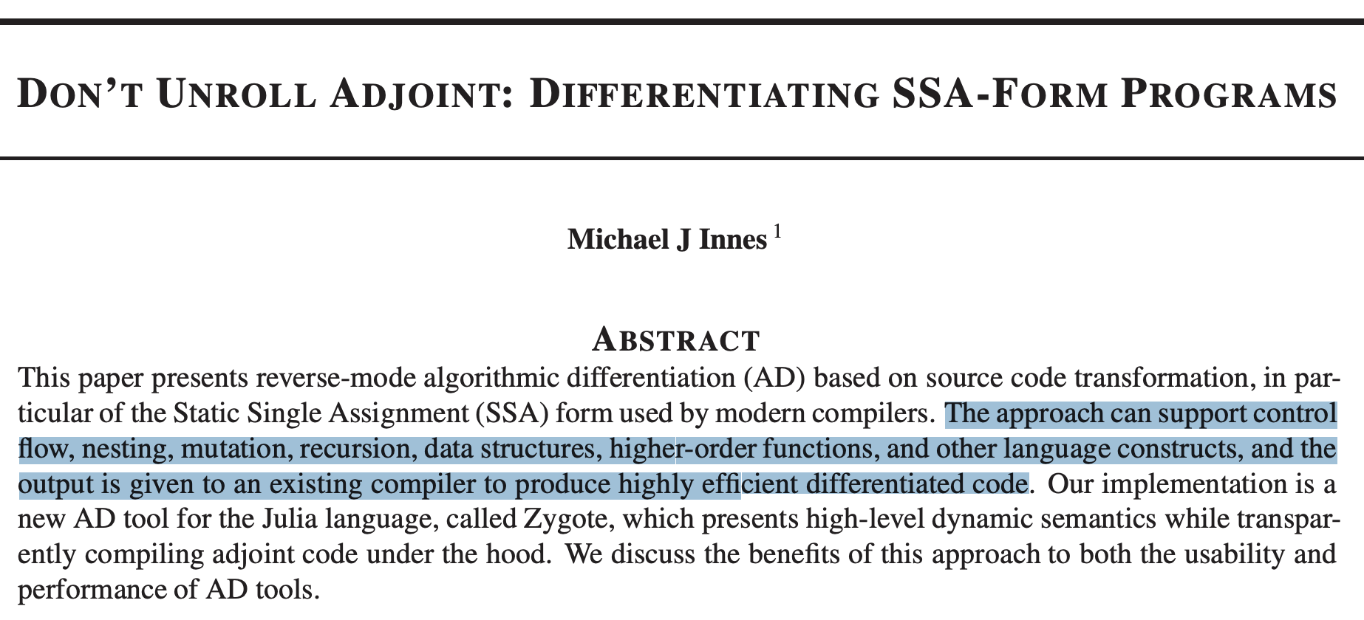
Zygote

Slide 6
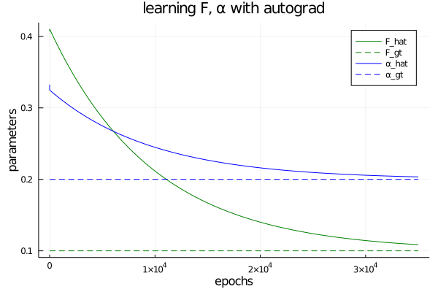
Differential method (two params)

Slide 7
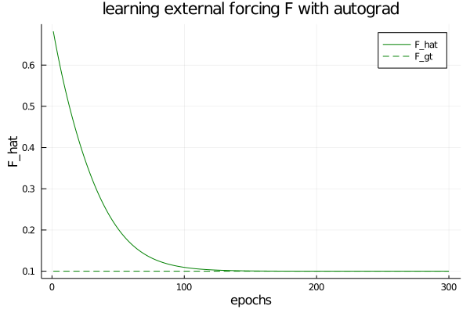
Differential programming method (one param)

Slide 8
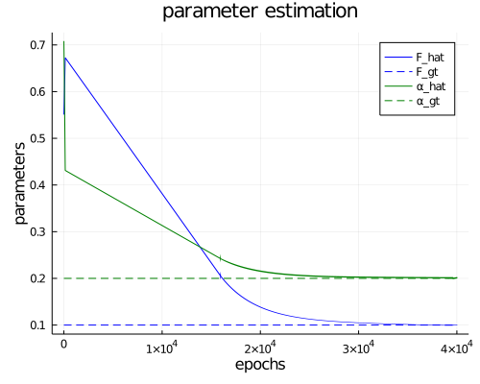
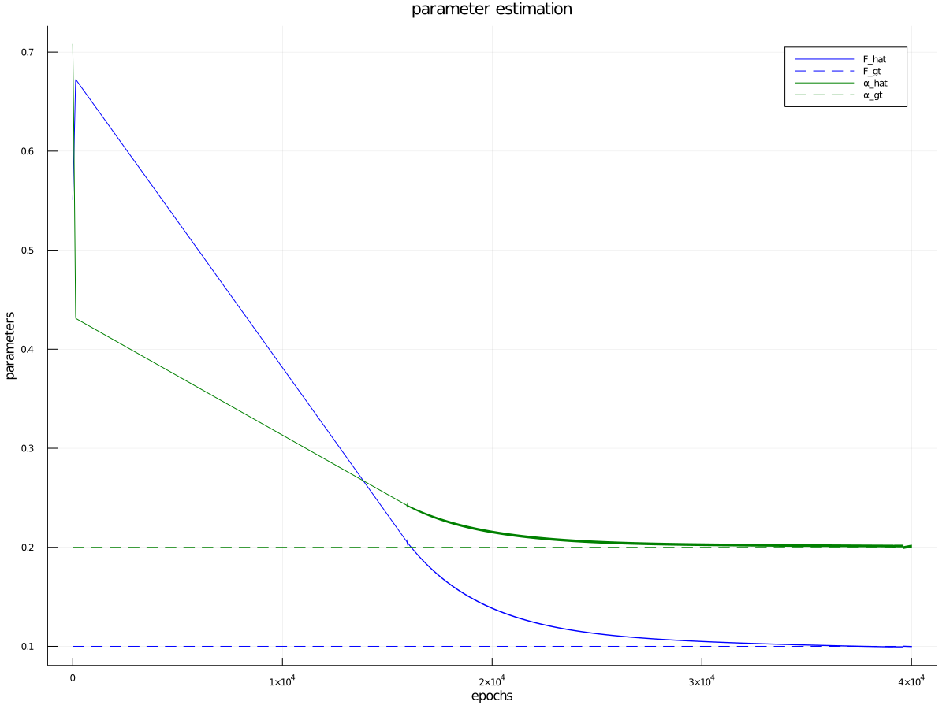
Analytic method (two params)

